Slide 1
Travel Agency Database
DBMS COURSE PROJECT
‘C1’ Batch – Team 1

Slide 2
Meet the team
Shreyas Joshi (322)
Abdul Majid (324)
01fe20bcs145
01fe20bcs147
Anoop patil (315)
Kirankumar Patil (328)
01fe20bcs138
01fe20bcs151

Slide 3
PROBLEM STATEMENT
A Private Firm Runs Travel Agency in Hubballi .
A Secured & Efficient Database has to be Created and Maintained to Manage the Agency.
-Travel Agency Offers Multiple Travel Packages for the Customers.
-No of days,Service Charges Differs from One Package to Another.
-Agency Hires One Employee to Handle Each Package.
-Agency Also Wants to Store Specific Data of Customers by Assigning them Unique ID.
-Each Package includes 3 Modes of Transport,Customers can choose based on their convenience.
-Agency also Gives 3 Accomodation Options to Customers Based on their Budget & Accomodation price will be same across All Packages.
-Every Customer Can book Single/Multiple Packages with their Desired Modifications in Travel Modes & Accomodation .

Slide 4
Tables of Database
01
02
03
04
Employee
Customers
Packages
Travel
Accomodation
Booking
05
06

Slide 5
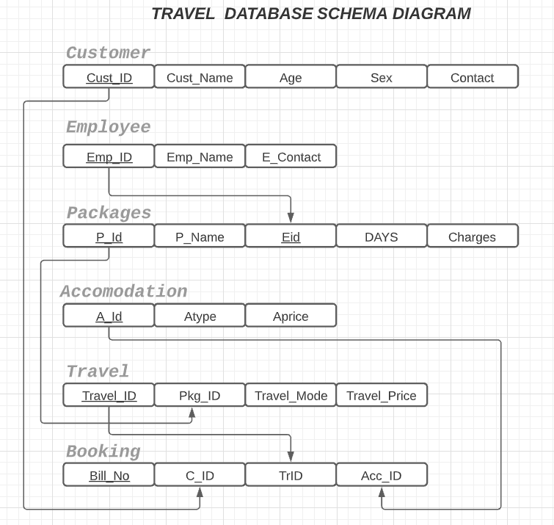
Schema of the Database

Slide 6
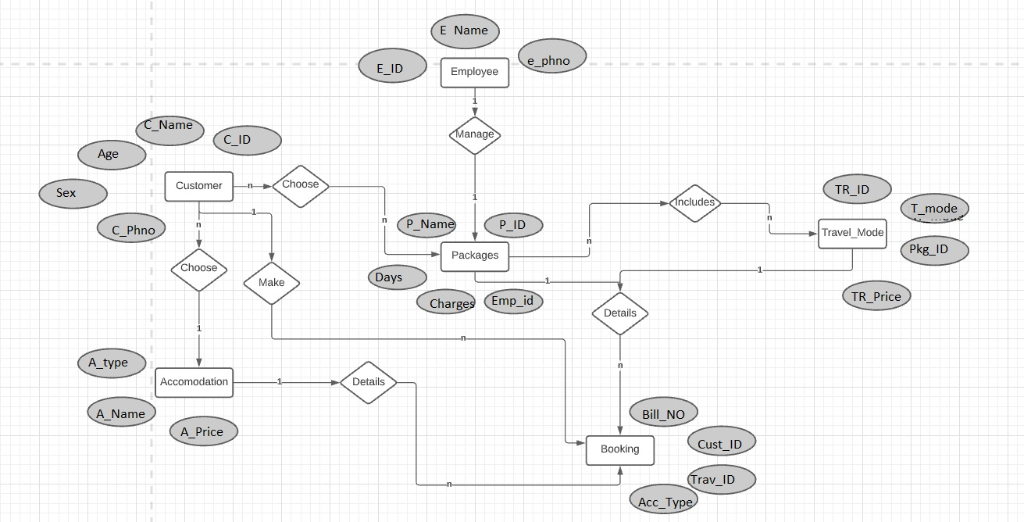
ER DIAGRAM of the Database

Slide 7
THANK YOU
“The world is a book and those who do not travel read only one page.”

